Slide 1



OLYLIFE
THE CHAMPION’S CHOICE

Slide 2

Product Concept
Respecting Nature
Appreciating Science
Healthy Lifestyle
Exercise + Nutrition + Equipment

Slide 3

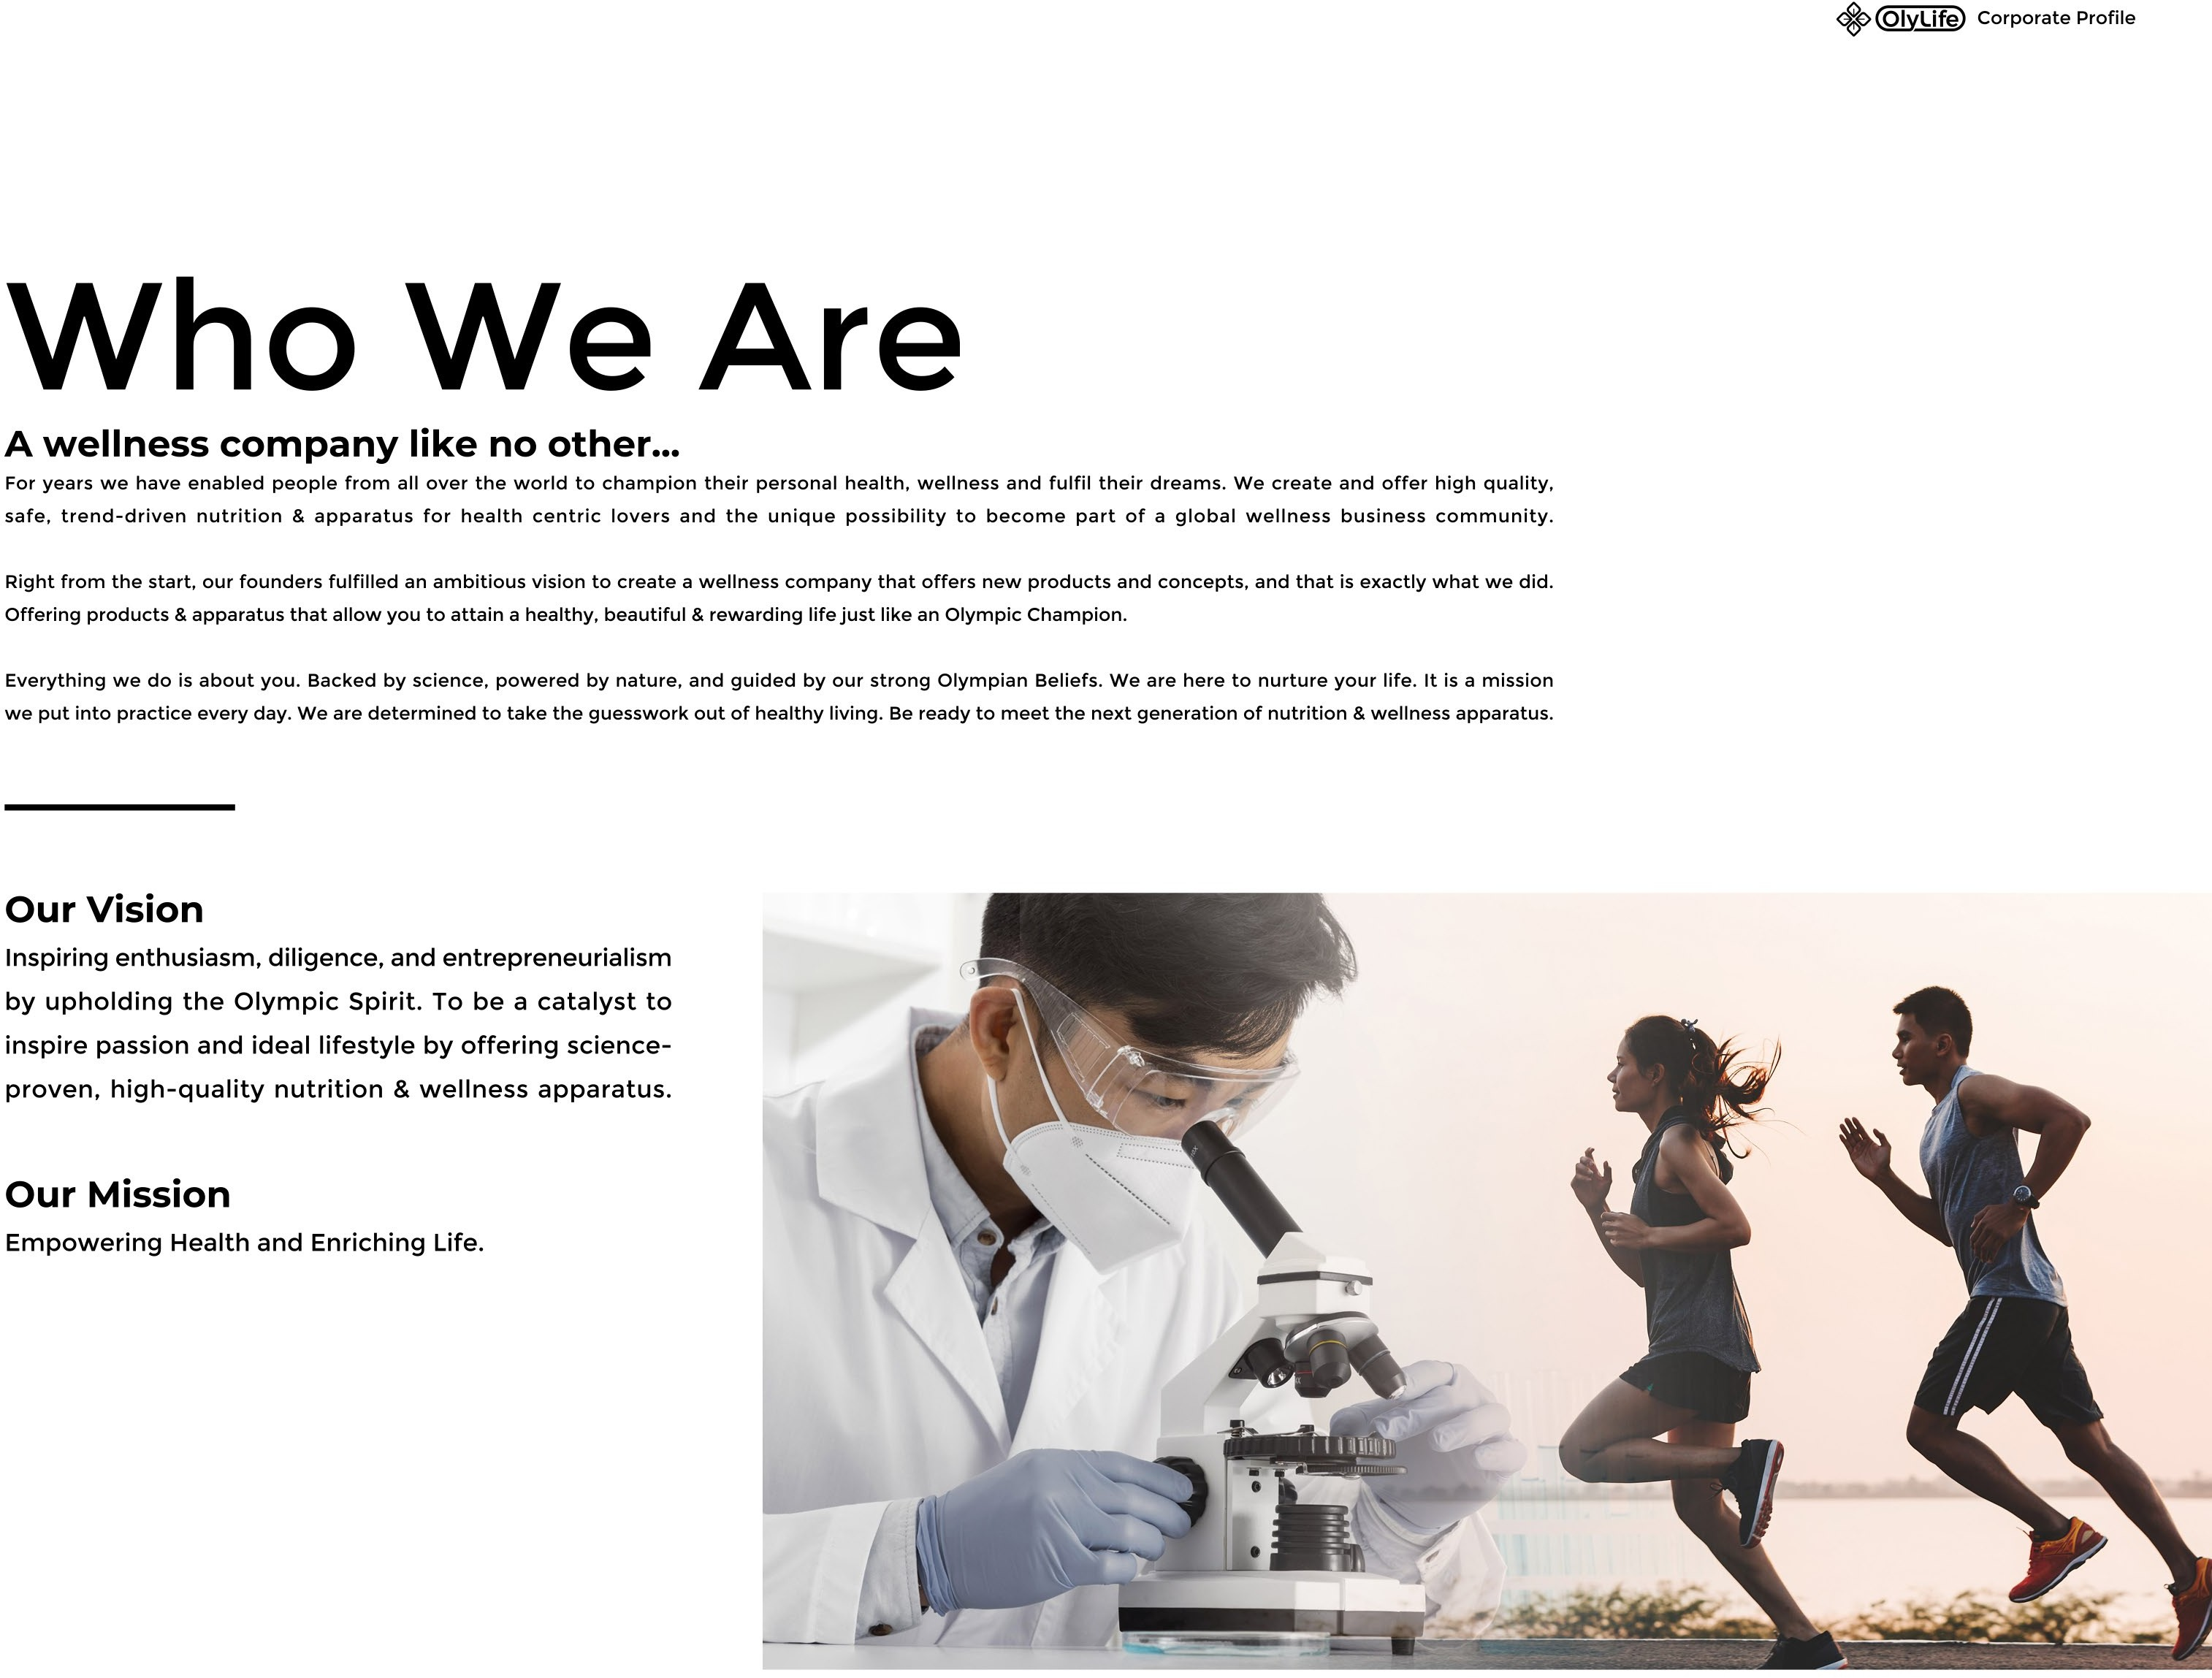
Who We Are
A wellness company like no other!
Mission
Empowering Health and Enriching Life
Vision
Inspiring enthusiasm, diligence, and enterprising spirit. By upholding the Olympic Spirit (Career).
Improve challenges passion and ideal lifestyle with high quality products.

Slide 4
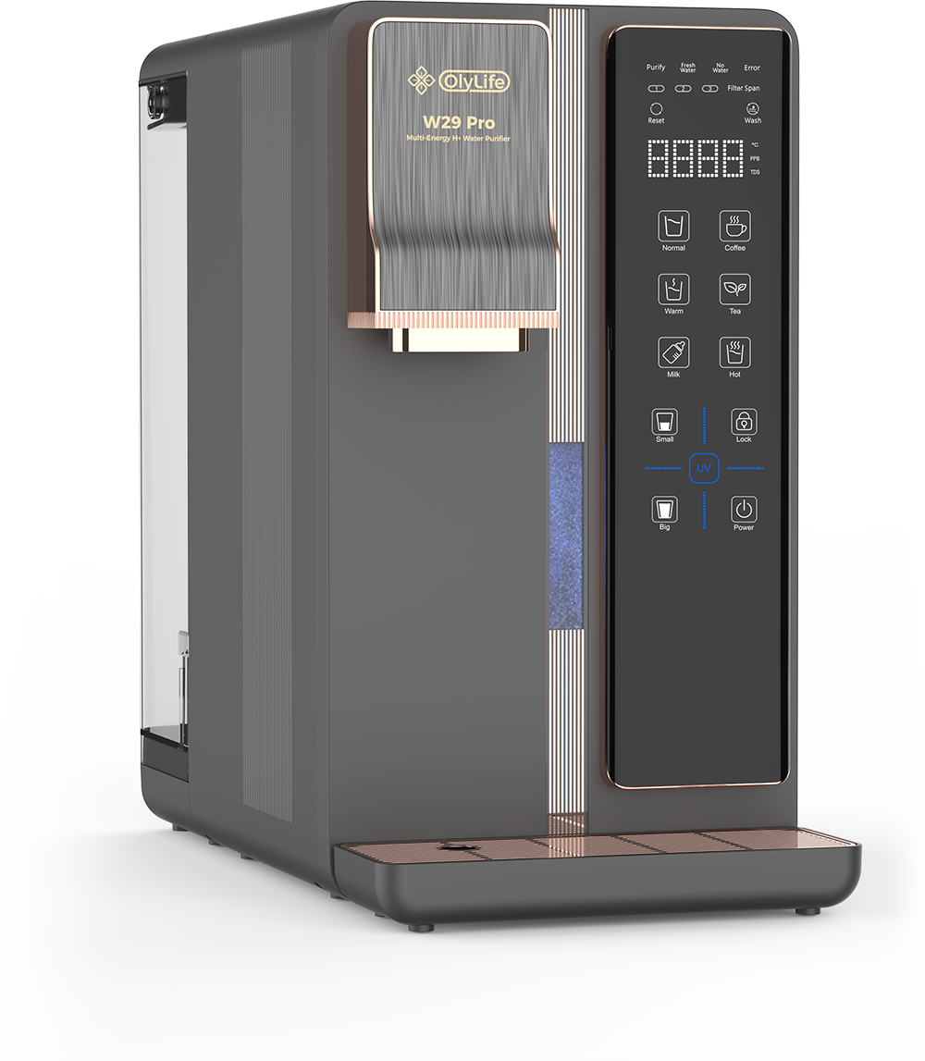

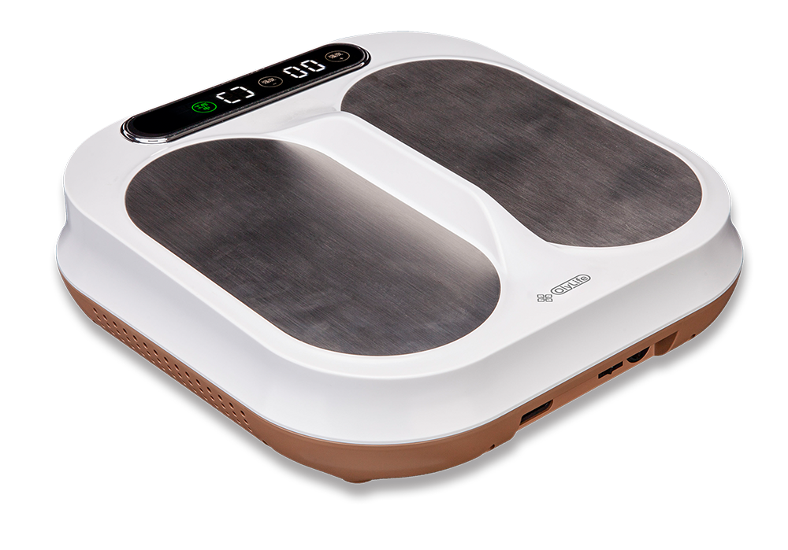
Health is the foundation of a desirable life
Some people improve immunity through supplements.
Some people improve body fitness through regular exercise for health purpose.
Water
Nutrition
Equipment
Guided by the Olympic spirit, OlyLife combines "water + nutrition + equipment" by emphasizing the importance of balanced nutrition.
Scientifically guided exercise.
Design products according to Olympic standards so that this Olympic spirit can be brought into our lives.

Slide 5
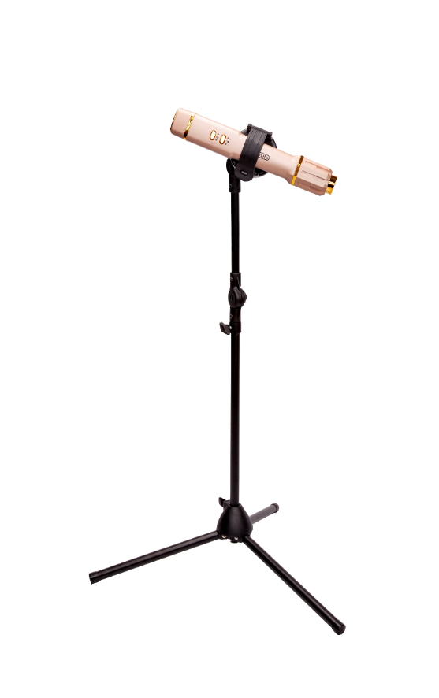
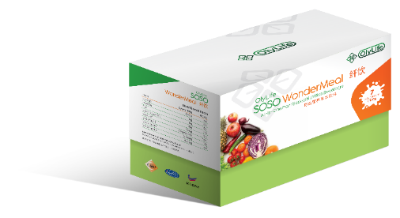
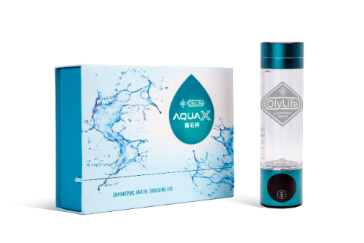
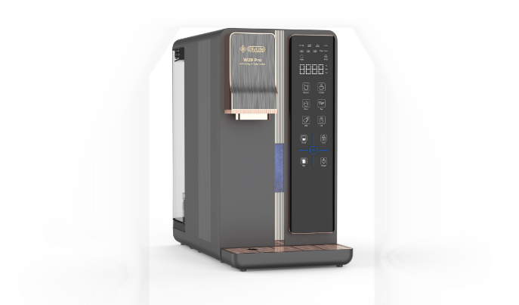
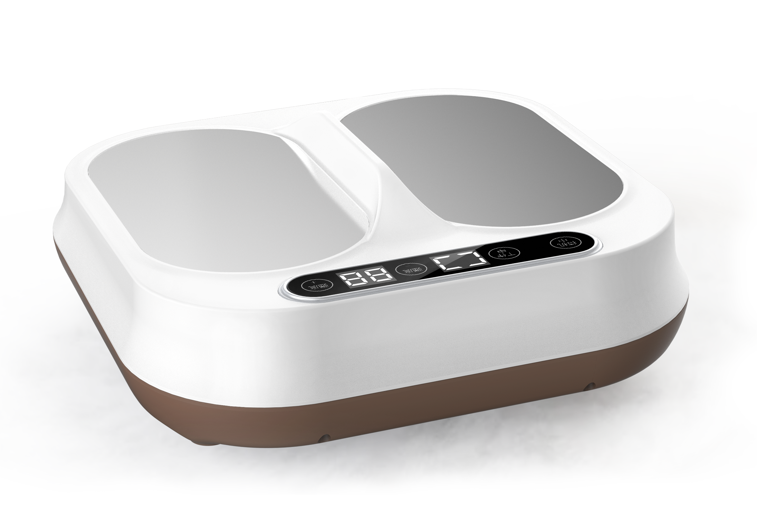
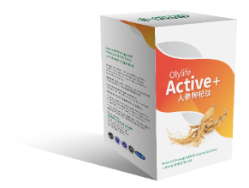

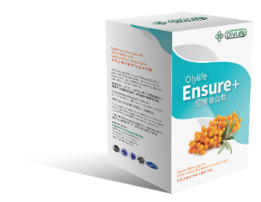



Nutrition + Equipment Therapies
Integrating water, nutrition & equipment
Nutrition
Equipment
Water

Slide 6

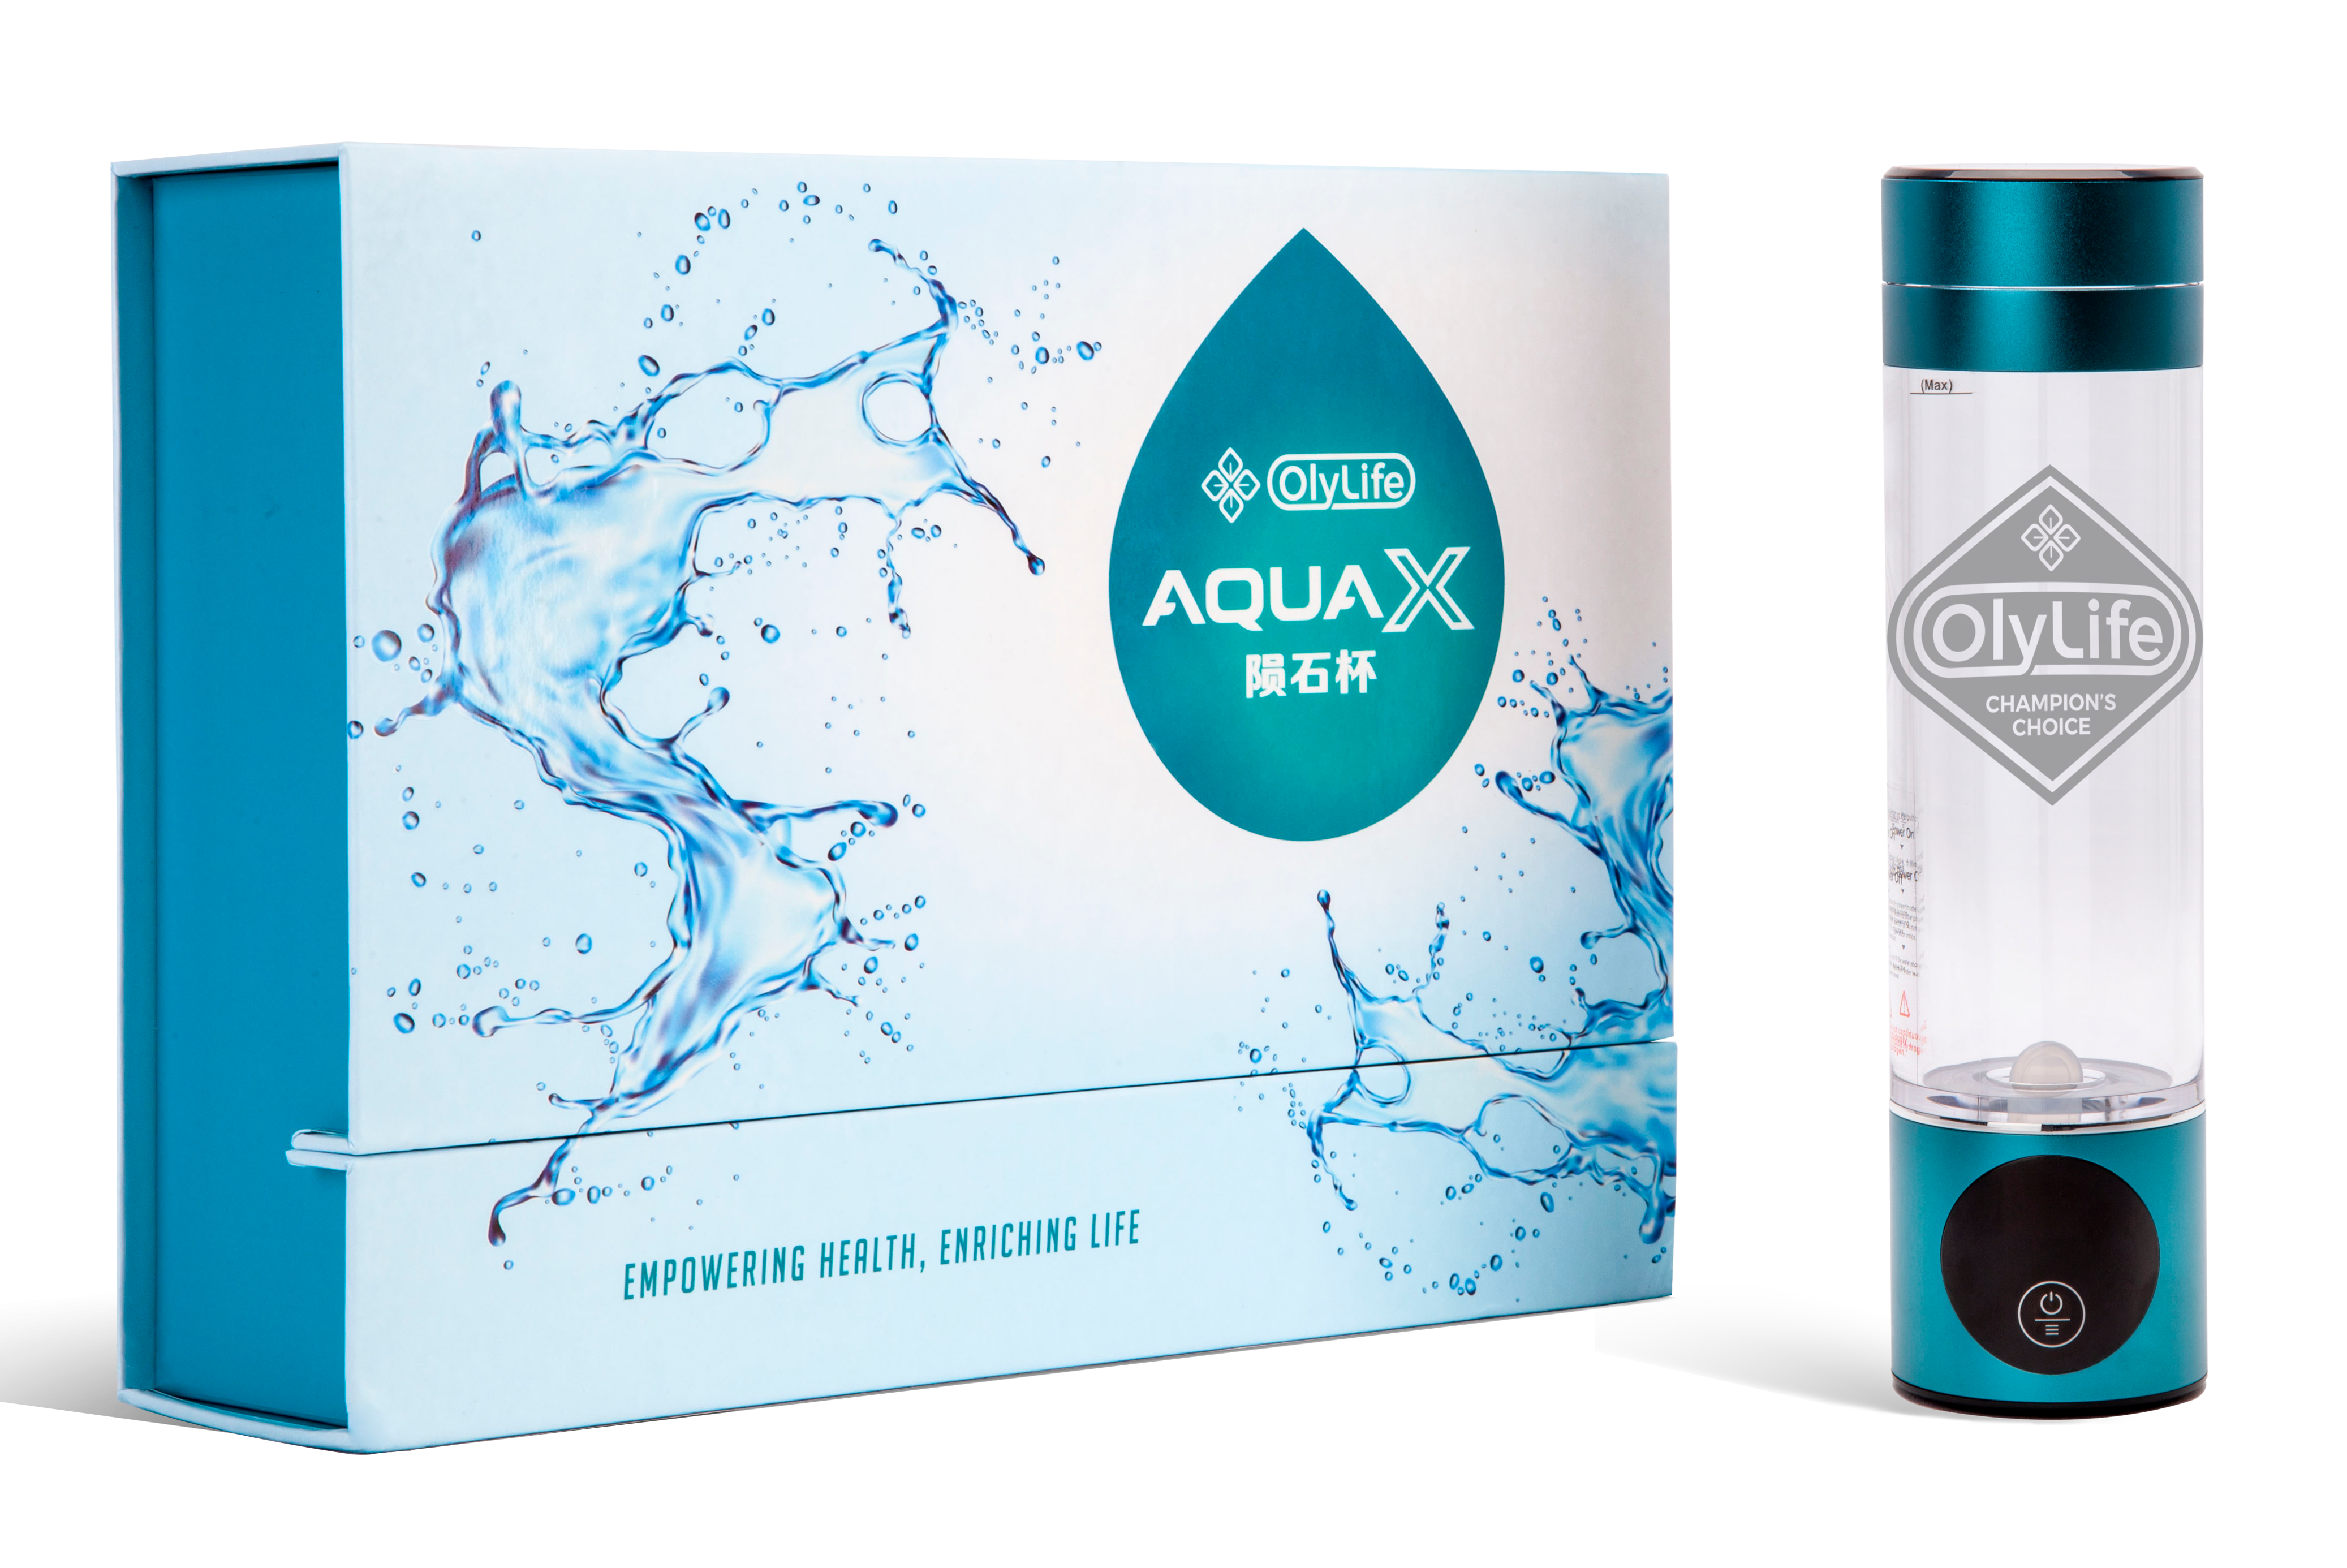
PRODUCTS
OlyLife W29 Pro Multi – Energy H + Water Purifier/OlyLife Aquax

Slide 7
PRODUCTS
Low Frequency Resonance
TeraHertz
Quantum Energy
Hydrogen Rich Water
Functional Water

Slide 8








PRODUCTS
OlyLife THz Cell Essential

Slide 9
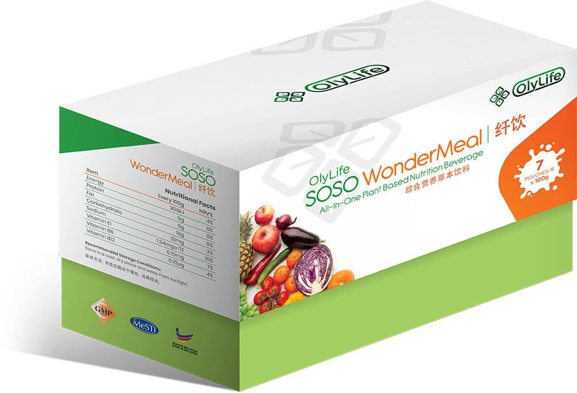
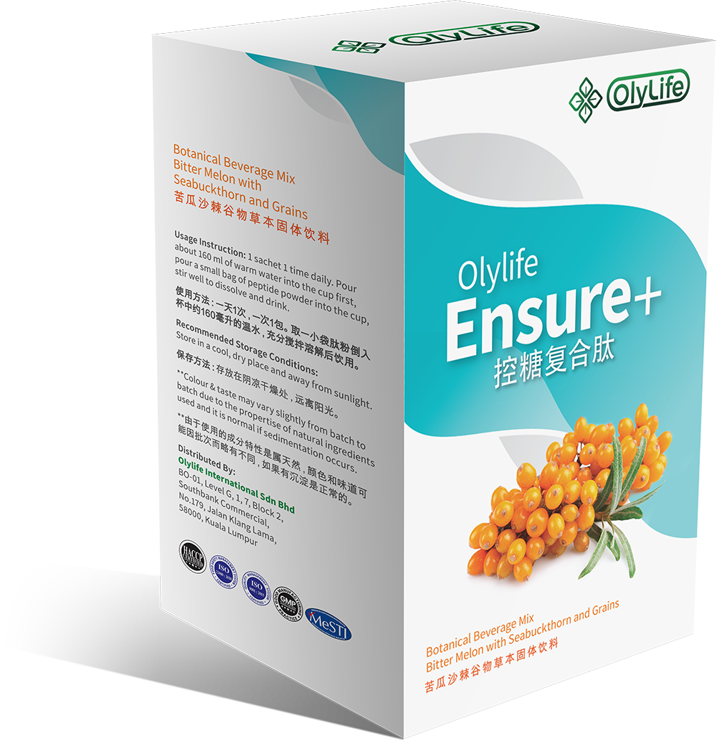
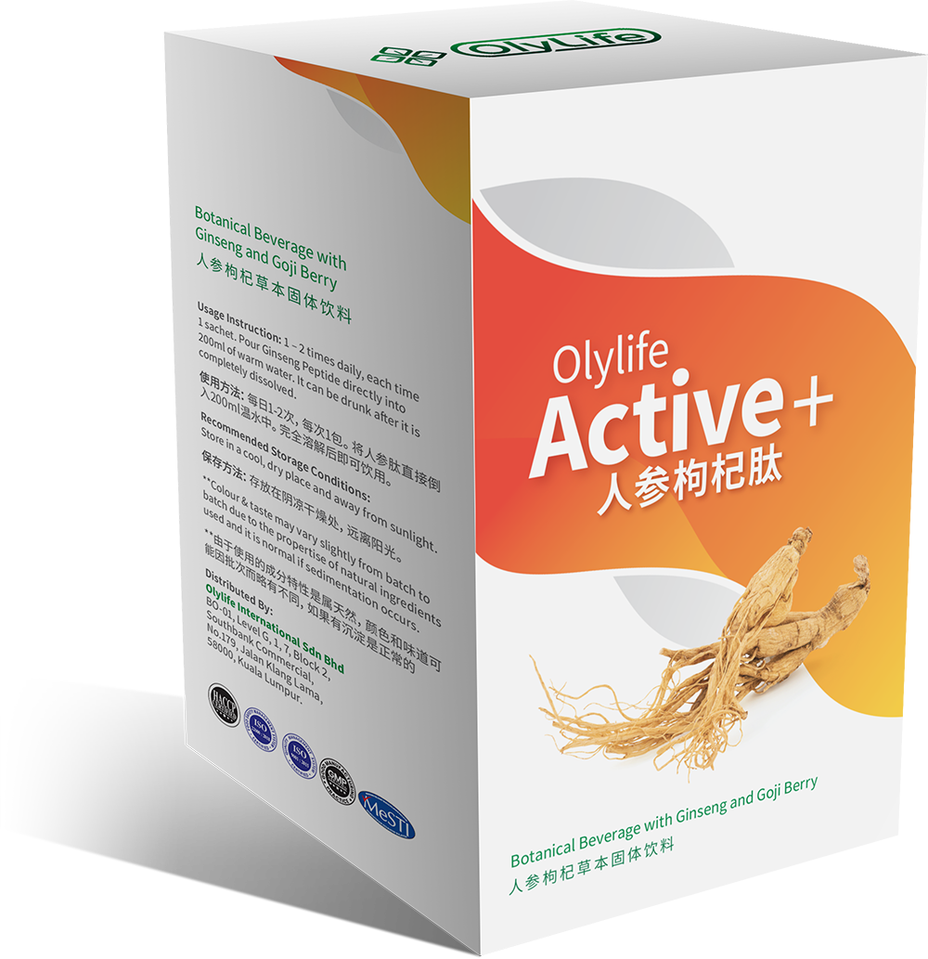
PRODUCTS
OlyLife SOSO WonderMeal
OlyLife WonderMeal
OlyLife Ensure+
OlyLife Active+

Slide 10
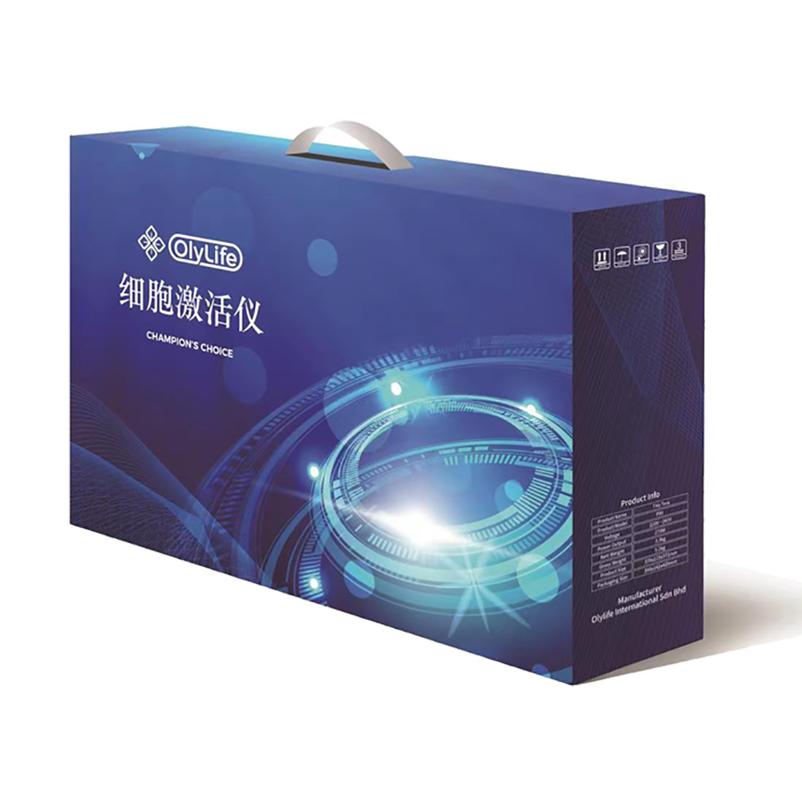
PRODUCTS
OlyLife THZ Tera P-90

Slide 11
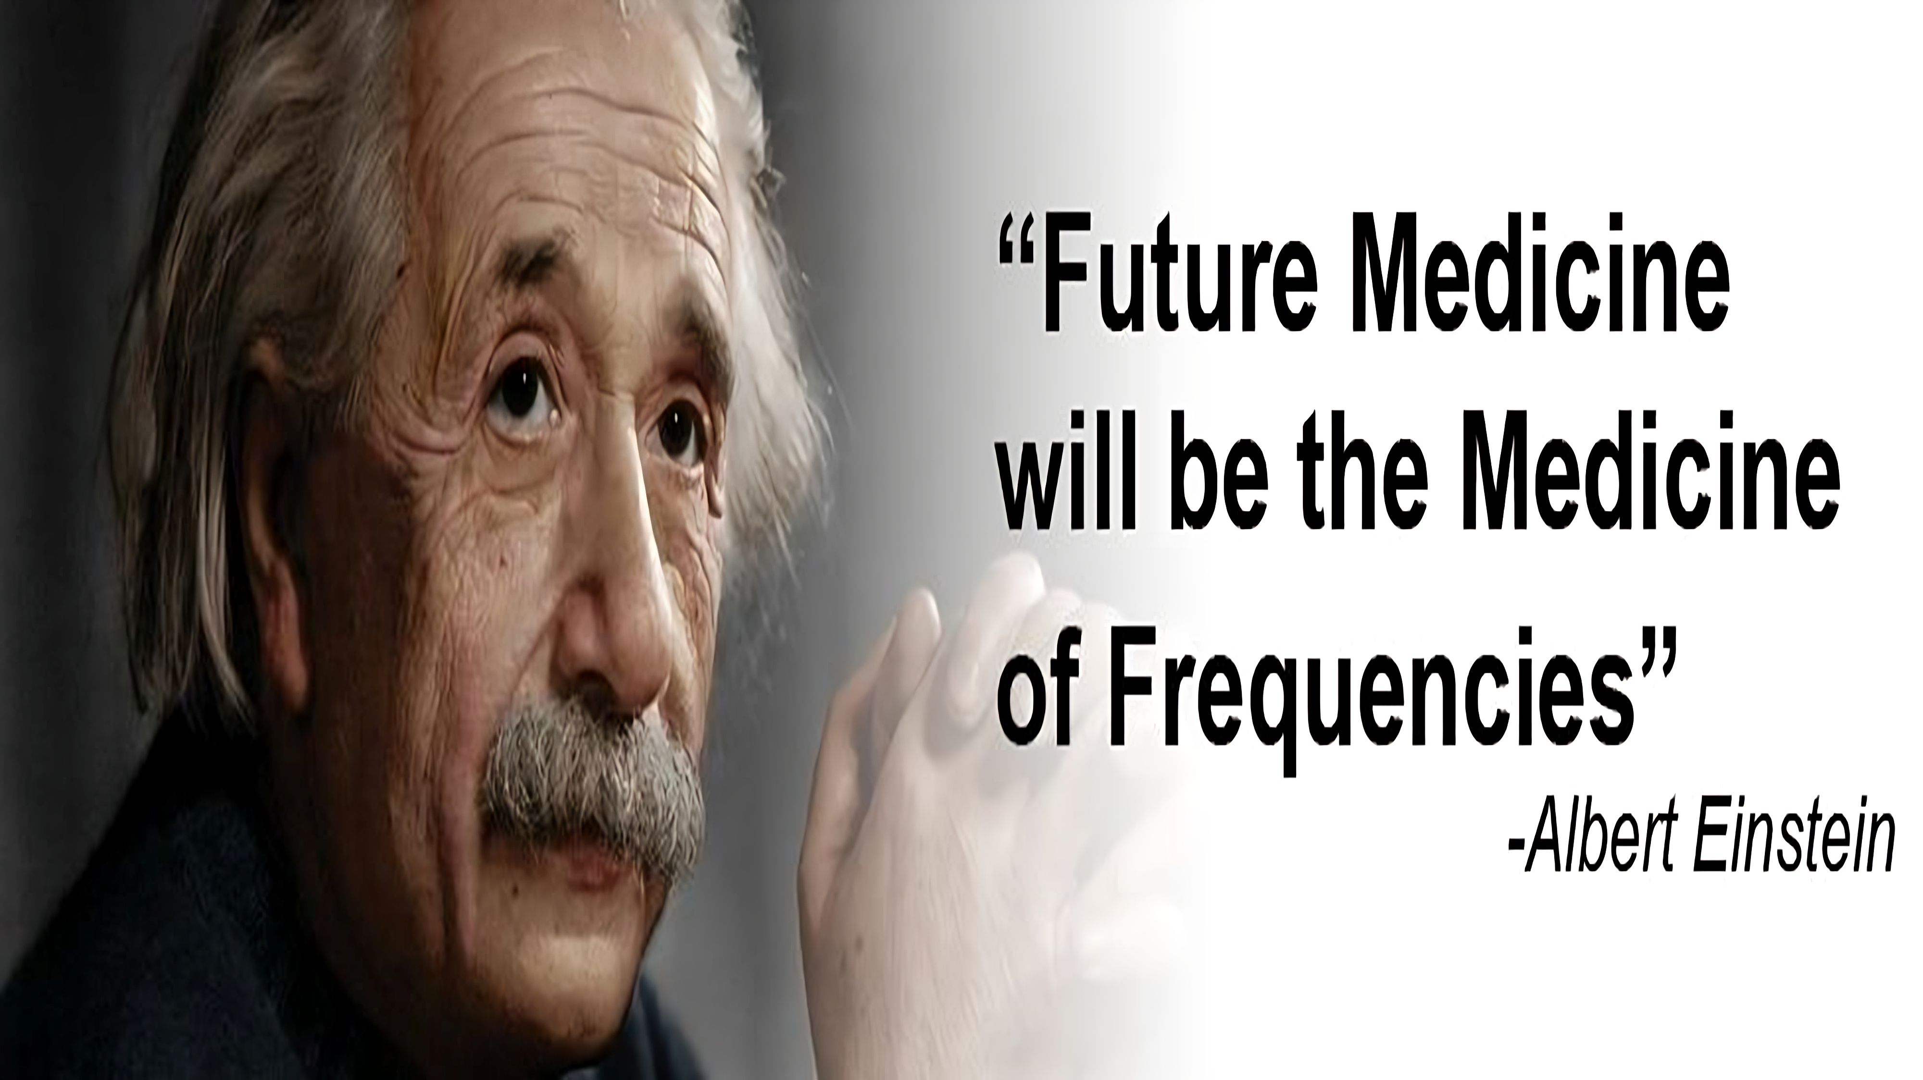

Slide 12

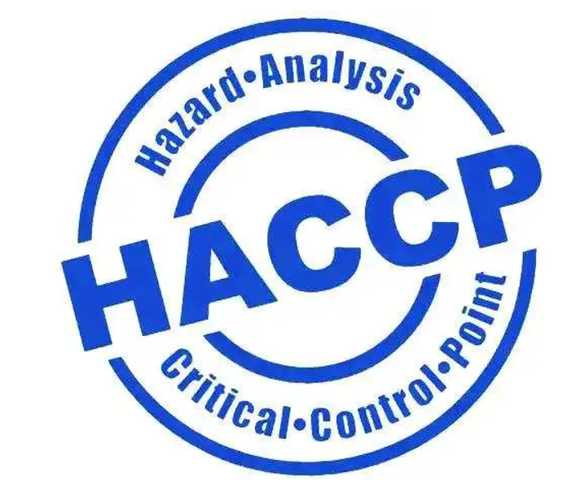
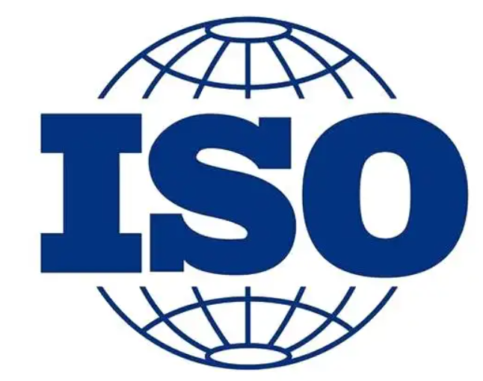


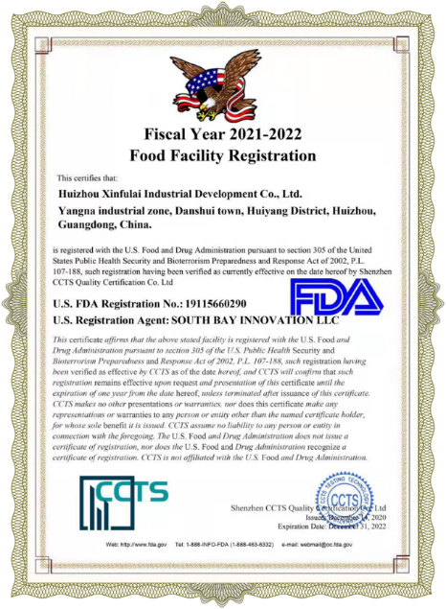
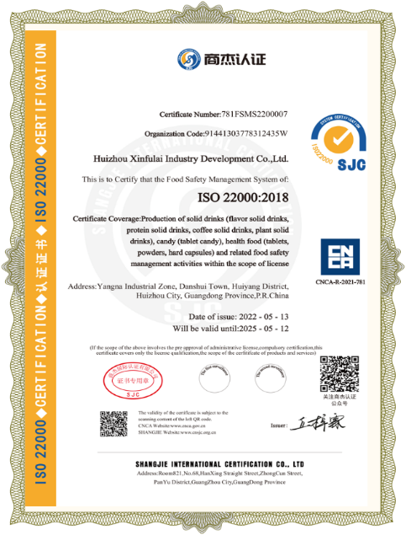
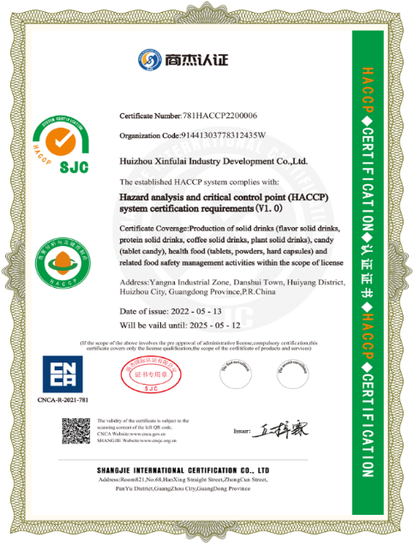
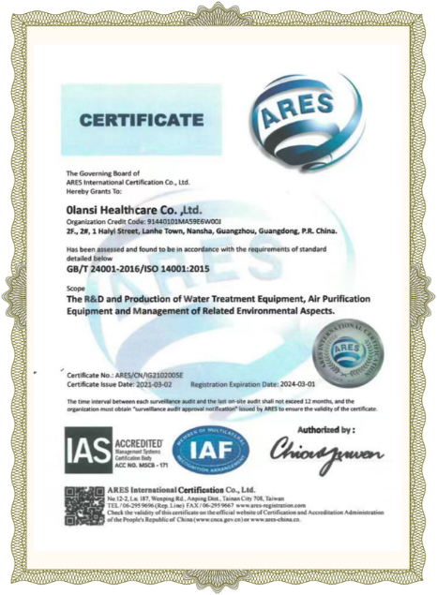
Product Certifications

Slide 13
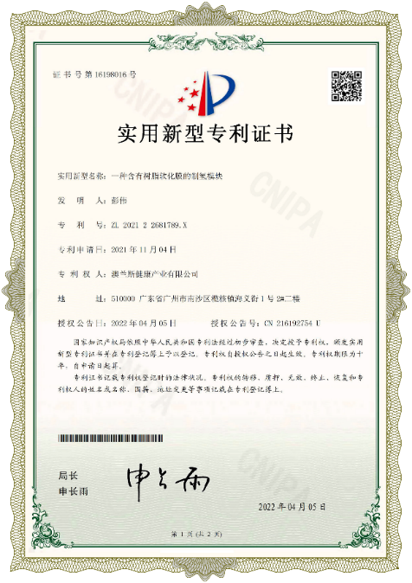
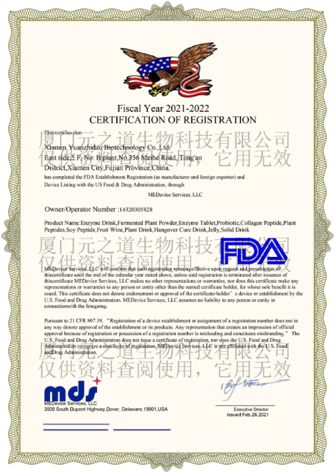
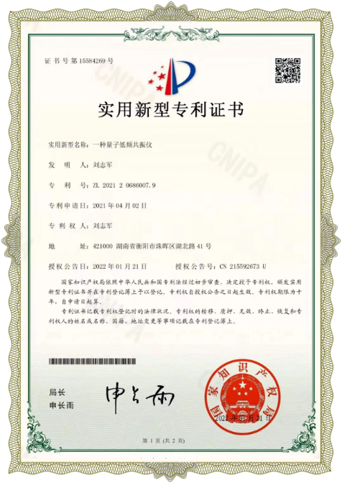
Patent Certification
158 patents

Slide 14
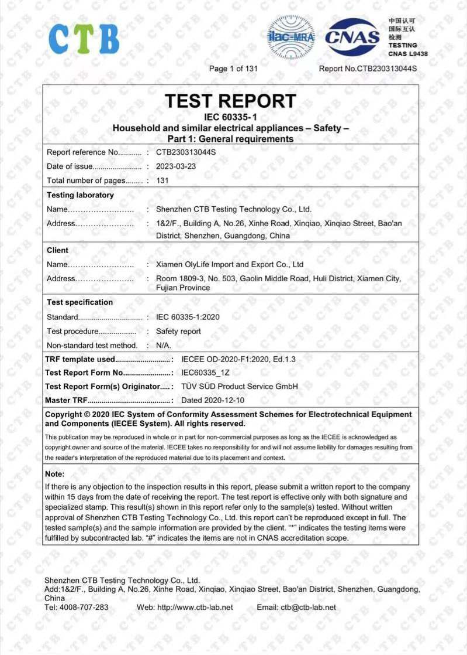
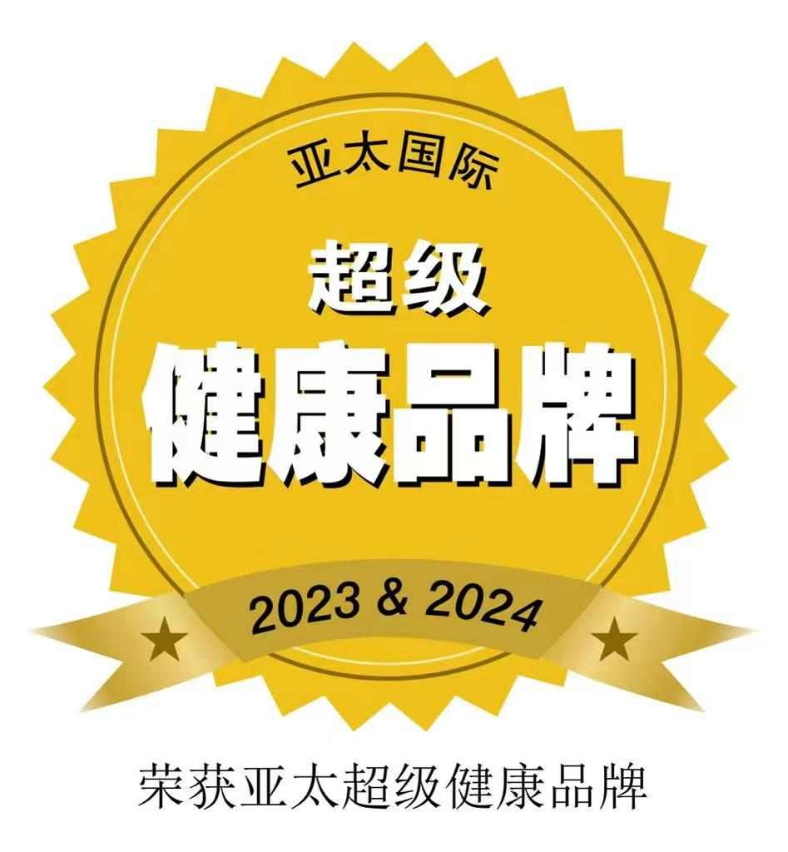
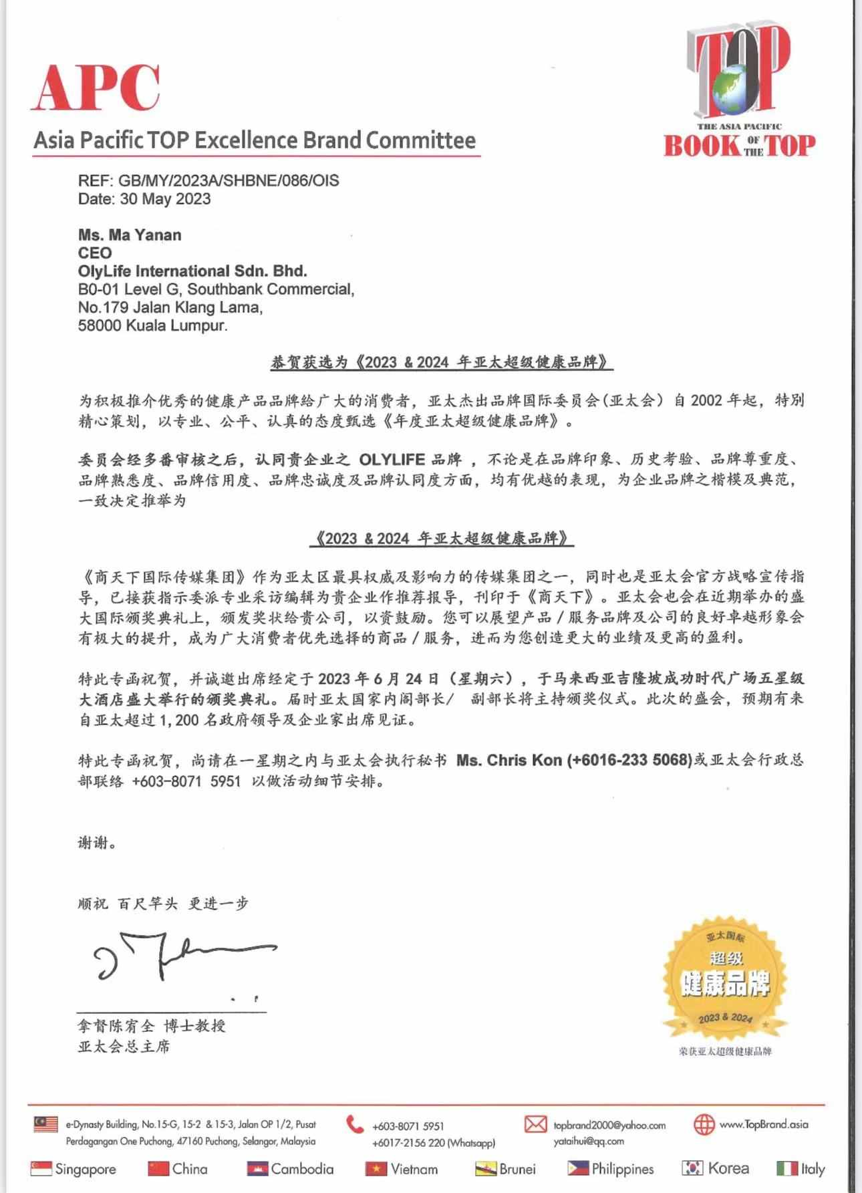

Slide 15



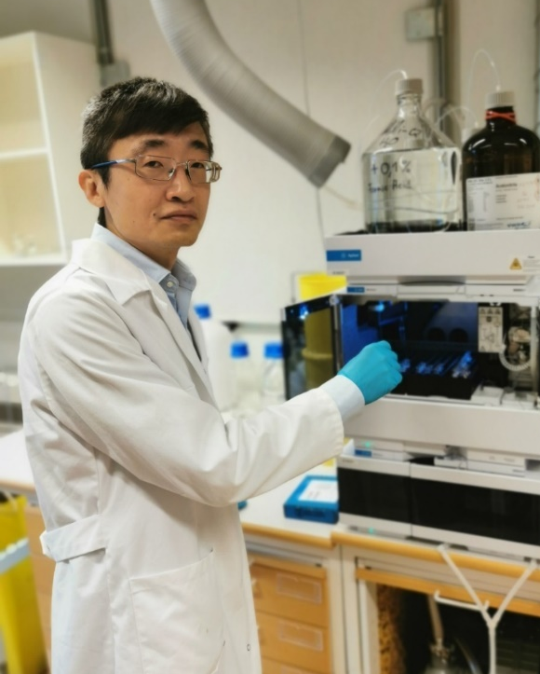

Professional Recognition
Dr. Yang Jie
Chief Scientific Advisor of OlyLife
He has a post Doctoral Degree at the University of Gothenburg in Sweden.
Project researcher at the Wallnberg Center for Molecular and Translational Medecine.
Assistant Professor at the Department of Chemistry and Molecular Biology at the Royal Swedish Academy of Sciences.
Founded in 1739, the Royal Swedish Academy of Sciences has a history of more than 280 years. It is the only scientific academy in the world that has achieved the most Nobel Prize winners.

Slide 16
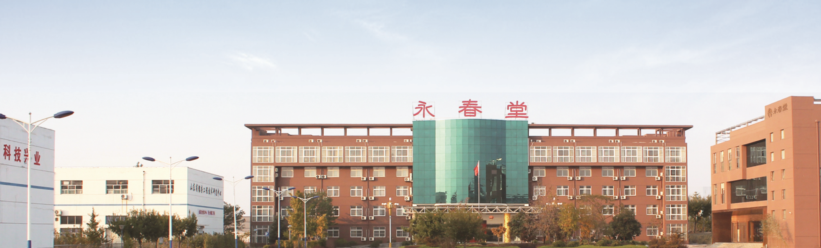

01
02
03
"Yong Chun Tang" was founded in 1999. It is a well-known “Large Health”& listed company in China. It obtained the valid direct sales license in China in 2015.
Yong Chun Tang Group of Companies is involved in the upstream, midstream, and downstream activities of the entire industry, including scientific research collaborations with higher institutions of learning and universities, to developing health products and commercializing the products.
Based on our philosophy, hand in hand, together we bring "OlyLife" to the world.
Notes:
Besides Dr Yang Jie, Yong Chun Tang is our mother company, It was founded in 1999 and is a well-known large health and listed company in China. In 2015, it had obtained the valid direct sales license in China. For your information, it is not easy to obtain a valid direct sales. Other than developing health products, it involved in other industry such as scientific research and etc.

Slide 17
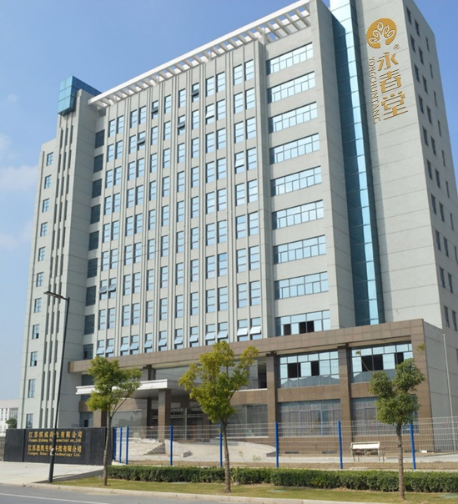
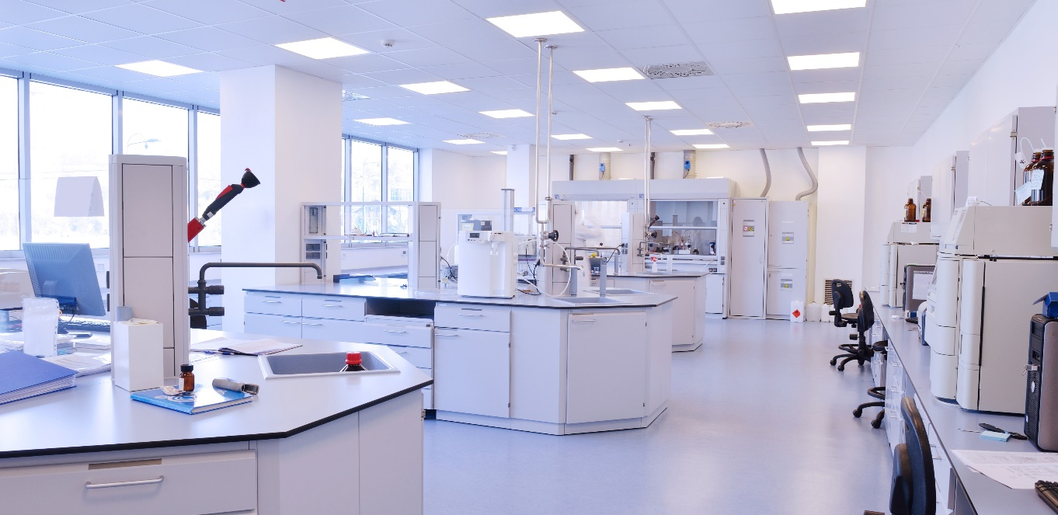

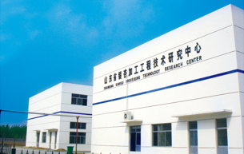
2 Production Base
Notes:
Yong Chun Tang has 2 production base which have its own research centre and manufacturing factory.

Slide 18


Corporate Milestone
Create Complete Intelligence:
OlyHome
Create 10k
Millionaire
Create 100k
Millionaire
Create 10k
Multimillionaire
Create Wholesome Health:
OlyHealth
2022
Malaysia
China
2023
Penetrate 10 countries
IN / TH / KR / SG
RU / VN / PH / TW
HK / BN
2024
Penetrate 50 countries
US / CA / AU
NZ / KH / AFRICA
BD / PG / OTHERS
2025
Penetrate 100 more countries

Slide 19
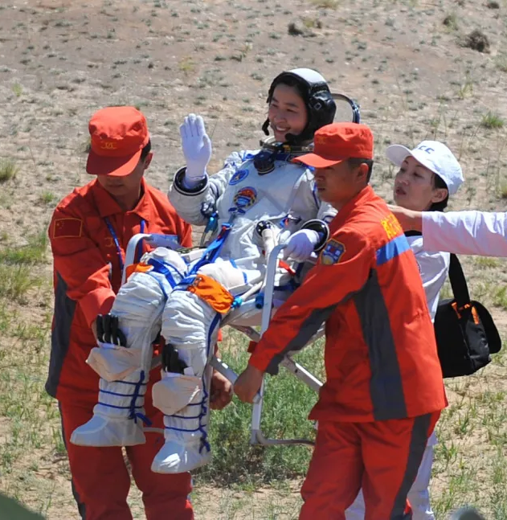
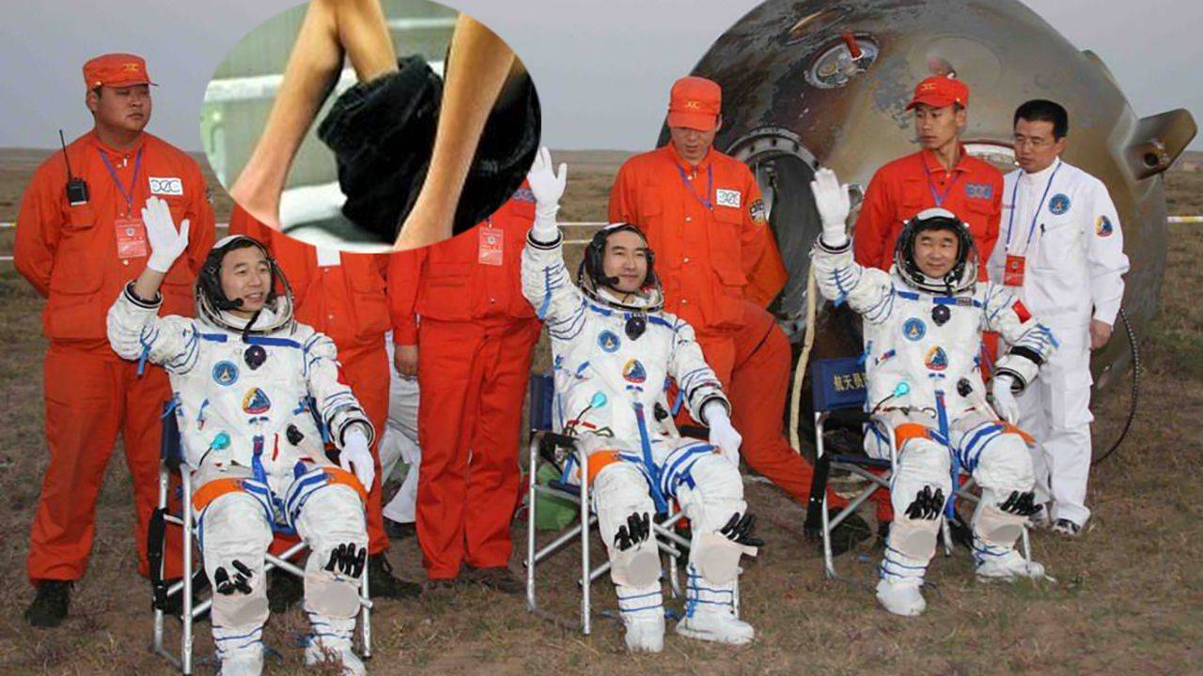

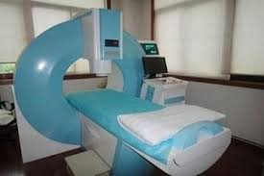
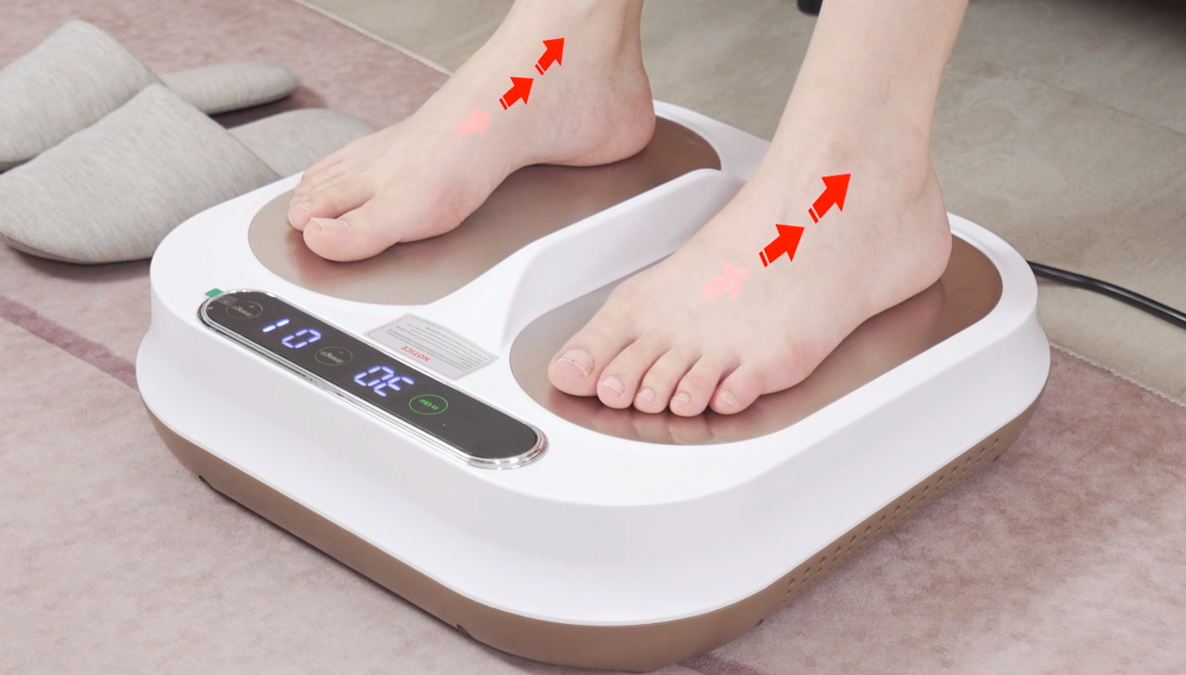
The department of medical supervision and medical insurance will also arrange for astronauts to enter a three-months recovery period to restore the astronauts ' physiological parameters back to their pre-flight state. It can improve the cardiovascular system and support organ function, improve standing endurance, and eliminate fatigue after flight.

Slide 20

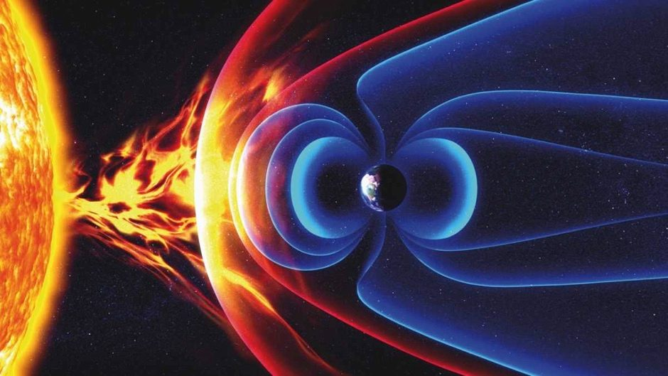
Geomagnetism
  Life on Earth appeared when the geomagnetic field was formed and increased to a certain strength. The huge magnetosphere formed by the earth’s magnetic field on the surface of the earth forms a natural protective barrier against the invasion of the outside world. Only living in a normal geomagnetic field can guarantee the health and continuation of life. Therefore, like sunlight, air, water, and nutrition, geomagnetism is the fifth element for life to survive.

Slide 21

Pulsed Electromagnetic Field Therapy
  Space Technology
  The National Aeronautics and Space Administration (NASA) had proven PEMF treatments can restore astronaut’s health, including reducing bone mass and muscle atrophy.

Slide 22

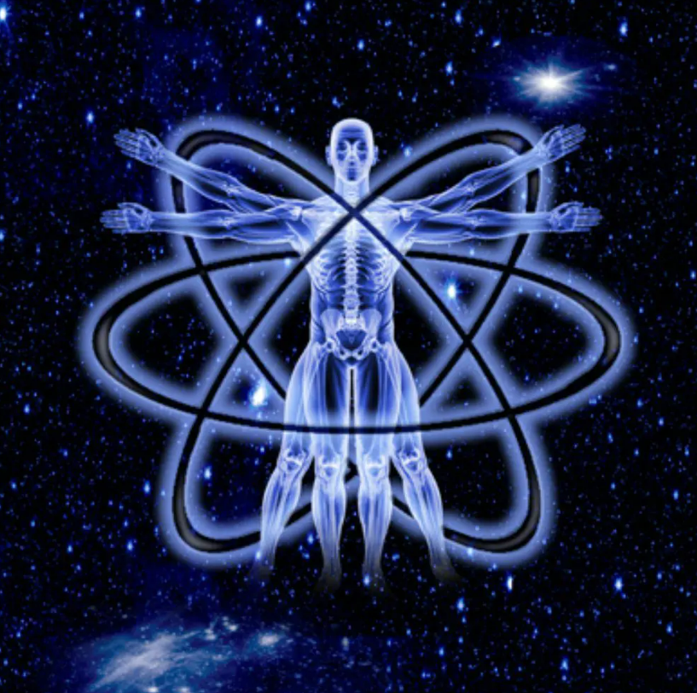
  Magnetic Therapy – PEMF Therapy
  To counter the gradual weakening of the earth’s magnetic force, the application of magnetic therapy can be used to properly compensate for and reduce the impact of the environment on the human body.

Slide 23


Everyone is at risk of infection.
How can we prevent a health crisis in 20 years?
Insurance
Deposit
Does it relieves pain caused by illness?
Prevention is better than cure
Stay healthly to embark on the road to the championship

Slide 24

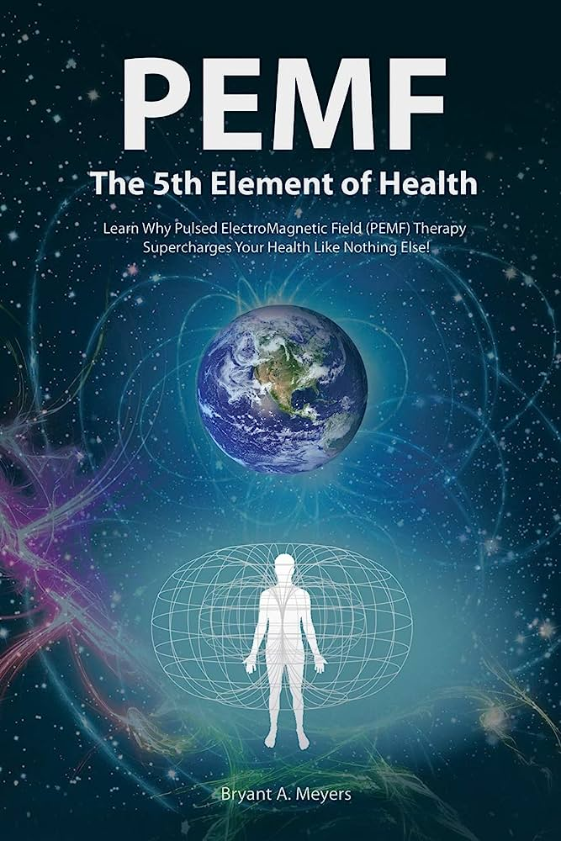
OlyLife Tera-P90 Double energy for overlapping effects
Bioelectromagnetic
Terahertz
8-1000μm focused band, the light of life.
Synergistic resonance with body molecules to improve microcirculation.
Good penetrating power, that can penetrate 4-5cm under the skin.
Safe and harmless.
1 Mhz high-intensity energy transfer.
Act on various parts of the body.
Heat from inside out, promote metabolism.
Cell to cell interaction.
Stimulate cellular immunity.

Slide 25
Let’s get started with our LEAD product!!!
Smart Physical Therapy Device
OlyLife Tera-P90
Bioelectromagnetic provides beneficial and health-enhancing electromagnetic frequencies to cells, activates cell functions, increase oxygen uptake and
Enhance self-healing ability to achieve an optimal health.

Slide 26

PRODUCT ADVANTAGES
OLYLIFE Tera-P90
Safe And Non-Invasive
It is a type of physical therapy. Magnetic therapy has no side effects, is healthy and comfortable, just like having a biological SPA. It is easy for everyone to accept and persist.
Simultaneous Improvement of Multiple Symptoms
By activating cells to promote the microcirculation of the body, it improves the root cause of sub-health problem, and various discomfort symptoms.
Simple Operation
One-button operation, multiple channels, intelligent adjustment, can be used at home and office.
Family Sharing
One instrument, shared by many people, low cost, high benefit, the choice for the whole family.

Slide 27
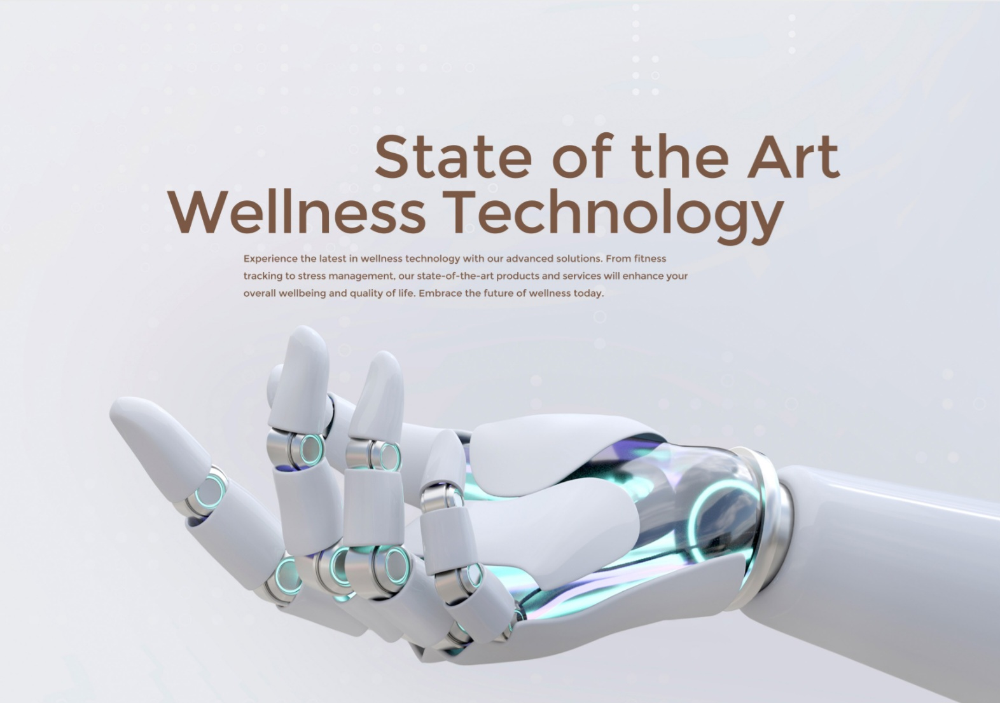
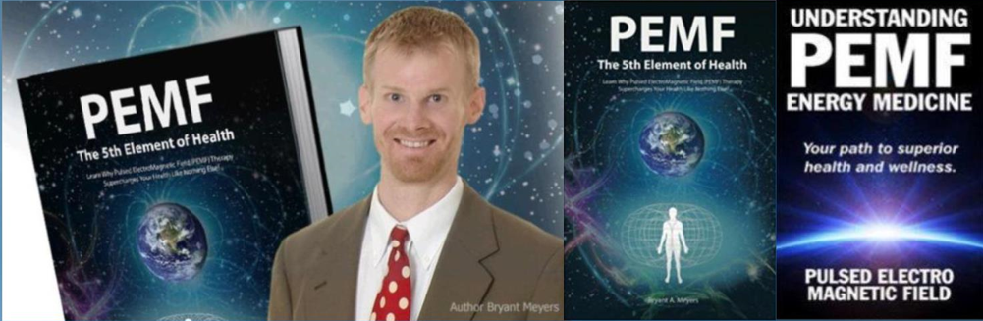
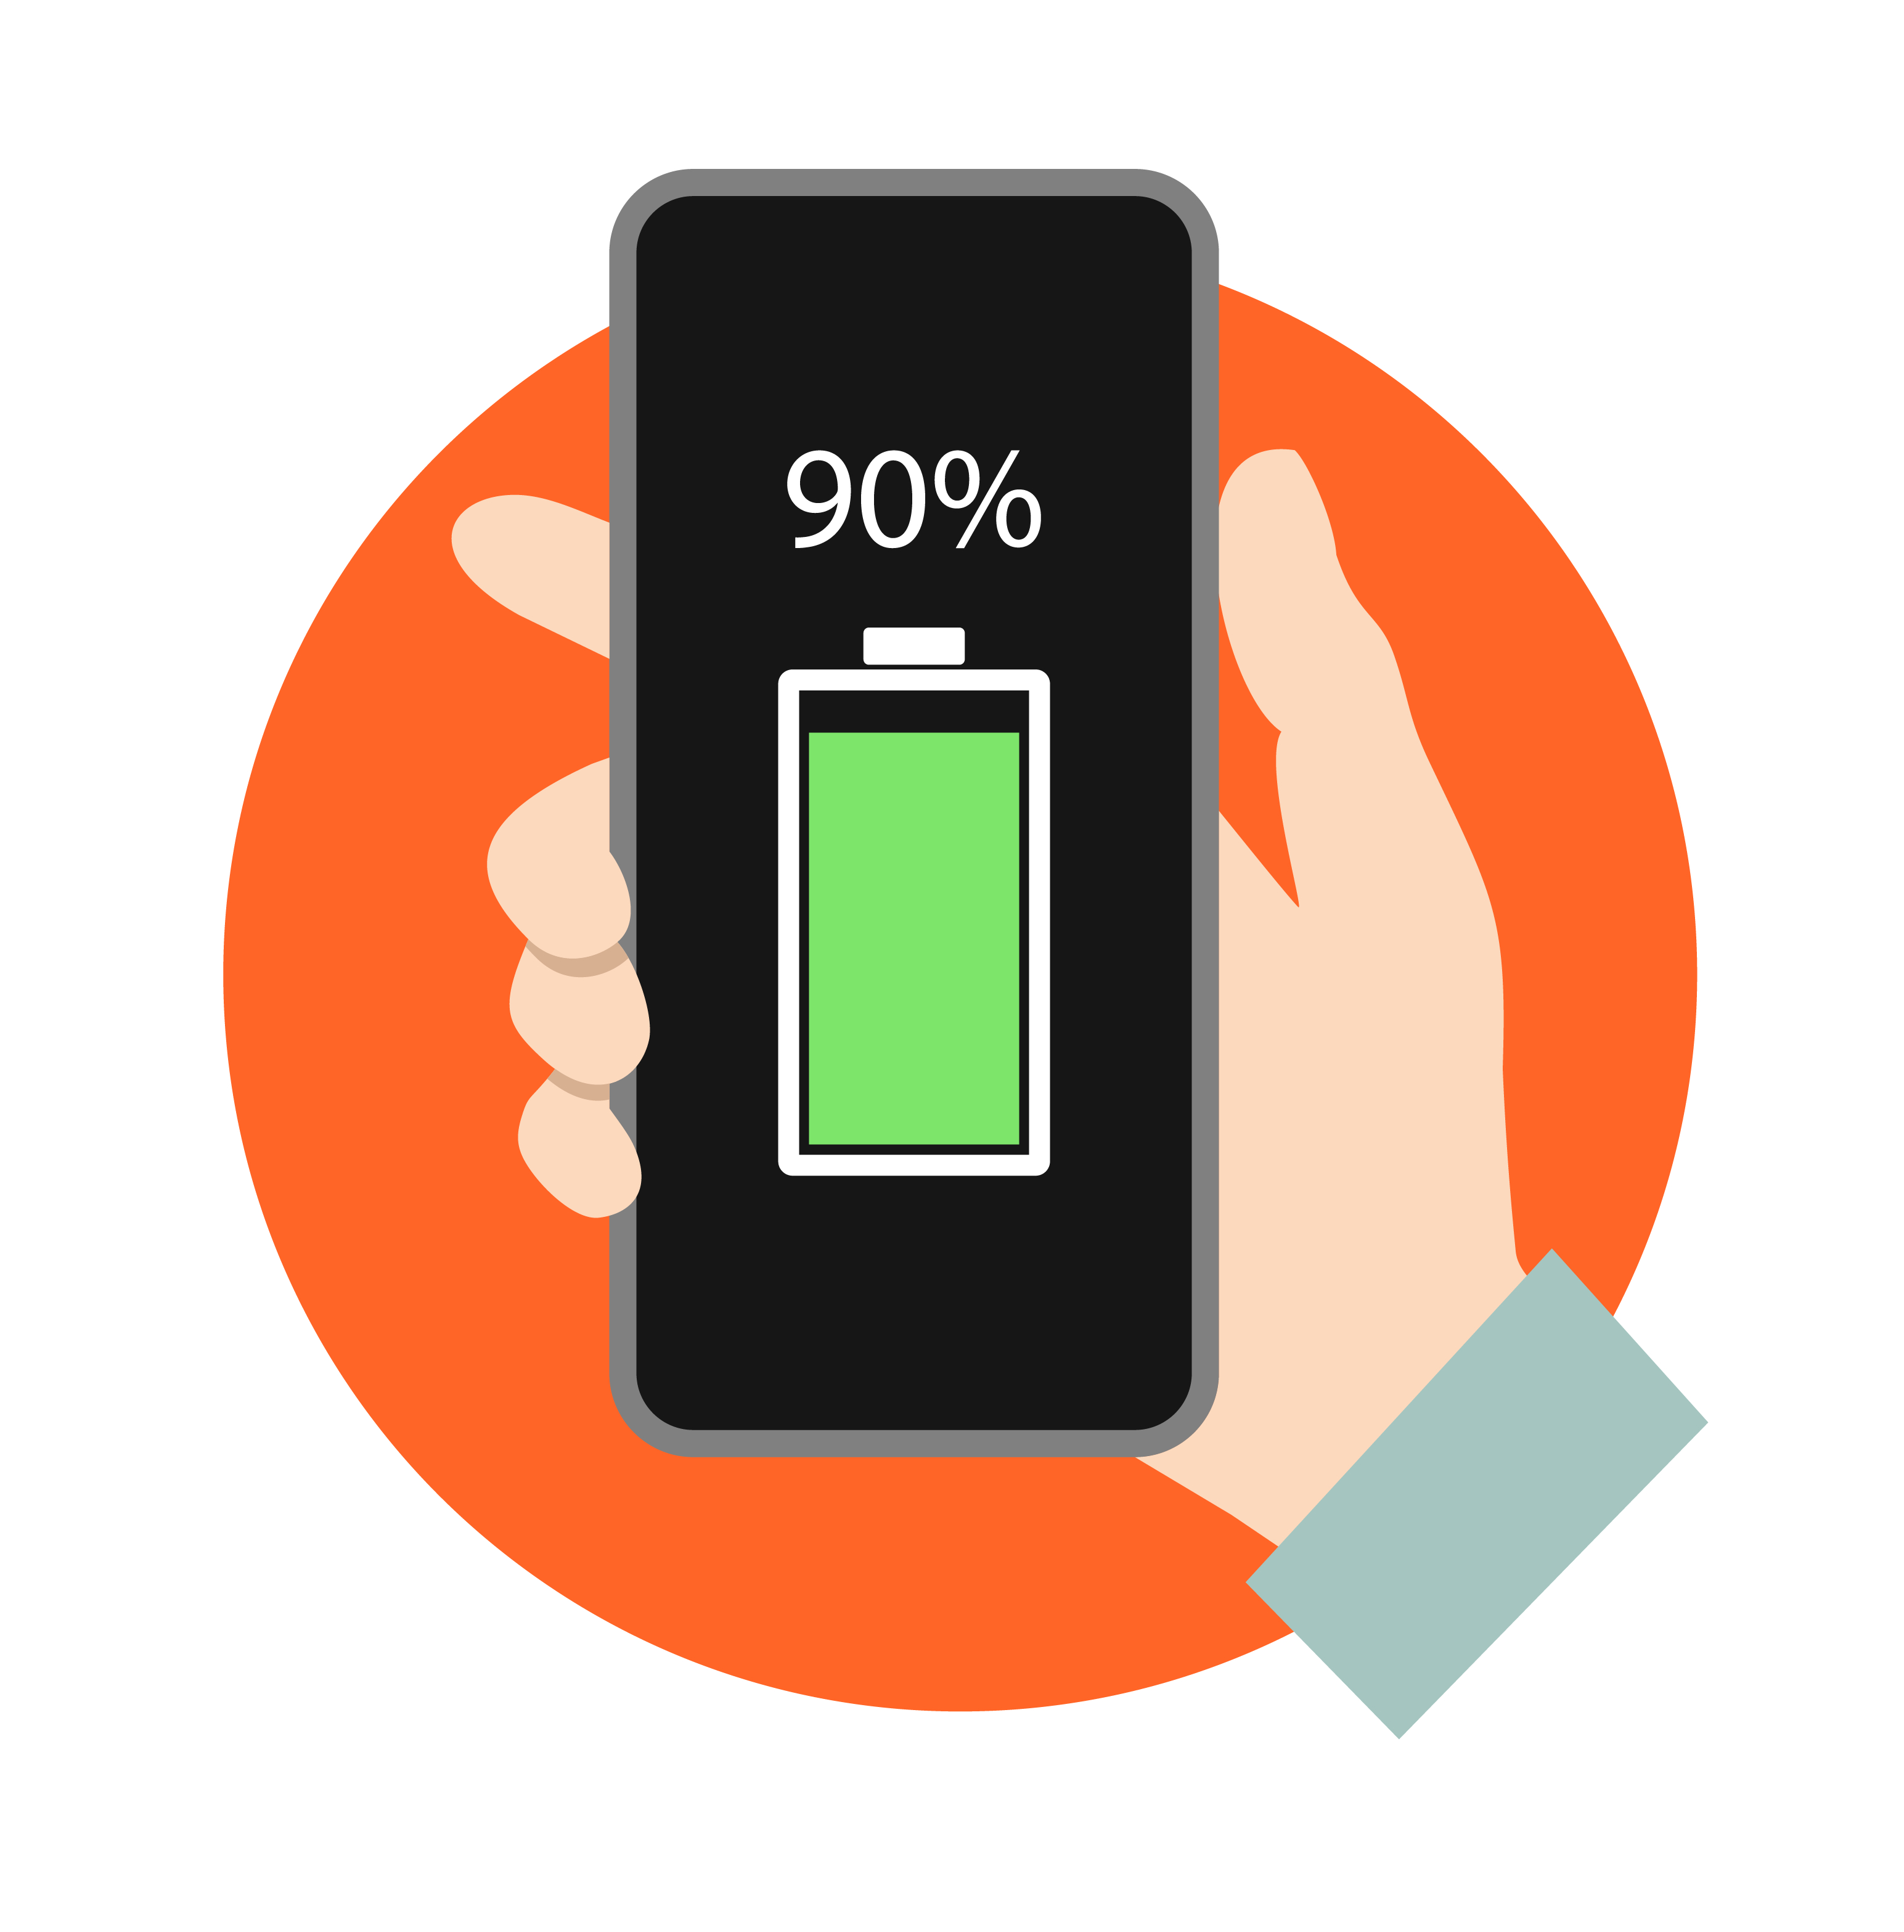
《PEMF The 5th Element of Health》
Written by Dr. Bryant Meyers of the United States
The Principle of Bioelectromagnetic
is like a charger, it can helps human body to receive energy.
3-5 times / minute
1 time/ minute
Youth
The pulse energy emitted by the human body is about 3-5 times per minute.
As we age,
the number of pulses our body emits decreases to about 1 time per minute, compared to about every 10 minutes in a diabetic patient.
The pulse energy emitted by diabetics is about 10 minutes 1 time.
It is also the cause of complications such as heart disease, diabetic foot and diabetic nephropathy.
These complications are also the leading cause of death and disability due to diabetes.
The PEMF can improve blood circulation and all parts of the body can receive blood. This is very important, because the human heart requires sufficient pressure to reach all parts of the human body.

Slide 28

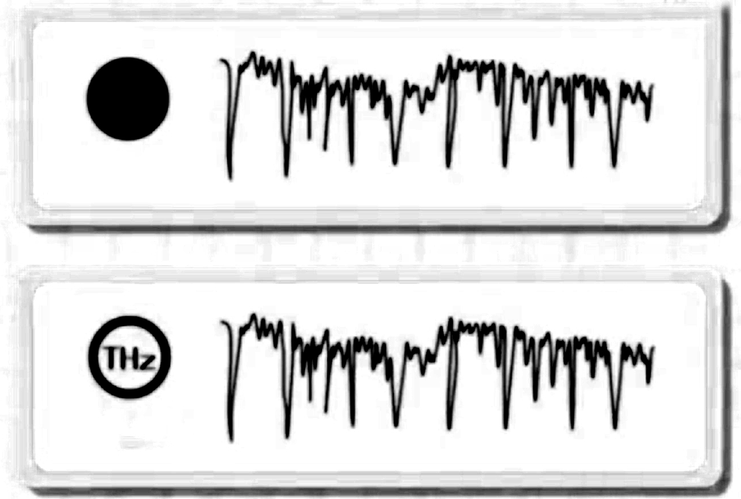
Terahertz waves resonate at the same frequency
as human cells
In the 1980s, American scientists discovered a kind of light with the same vibration frequency as normal cells and it was called Terahertz waves.
Normal cell
Terahertz waves

Slide 29


Why choose OlyLife Tera P-90?
Activate
Promote
Eliminate
6 Long-Term Use Benefits
OlyLife Tera-P90
Activates cells & energy
Promotes microcirculation, metabolism and meridians
Eliminate cold-dampness
Remove
Burn
Relieve
Removes toxins & waste
Burn fat & body shaping
Relieves inflammation, pain & fatigue

Slide 30
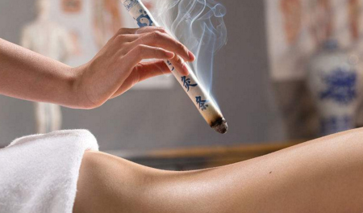

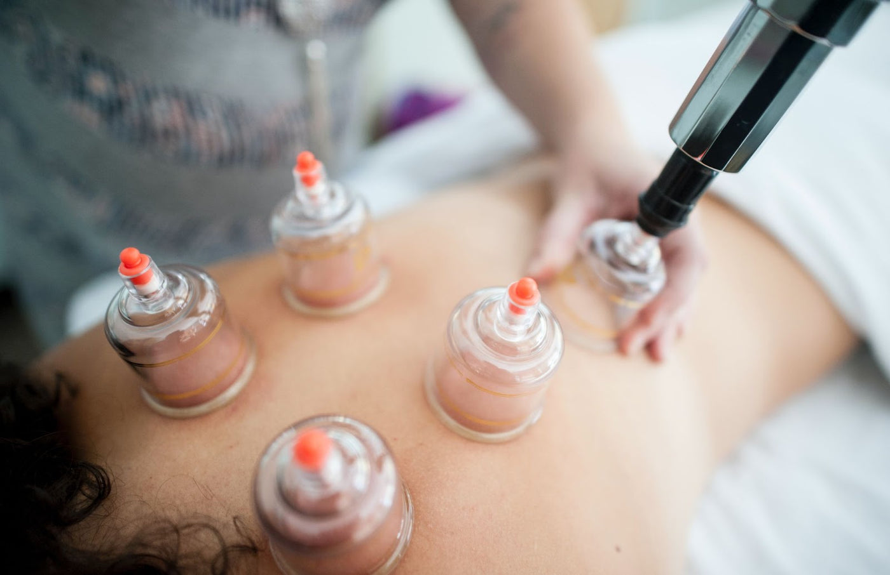
OlyLife THZ Tera P-90
POTENT EFFECT
30 MINUTES PER TREATMENT
10 times of Moxibustion
30 times of Massage
20 times of Cupping/Ventusa
30 massage costs about ₱58,000 per person,
what about family?
Who can do 30 massages a day?

Slide 31
Pulsed Magnetoelectricity
The Efficacy of Tera-P90
Promote Microcirculation Improve Lymphatic Damage
Promote Metabolism Regulates Organ’s Function
Stimulates Cell Activity Activate Gonads
Improve Obesity Remove Impurities In Body
Relive Muscle Strain Eliminates Inflammation
Collagen Regeneration Delay Aging
Smoothen Wrinkles

Slide 32
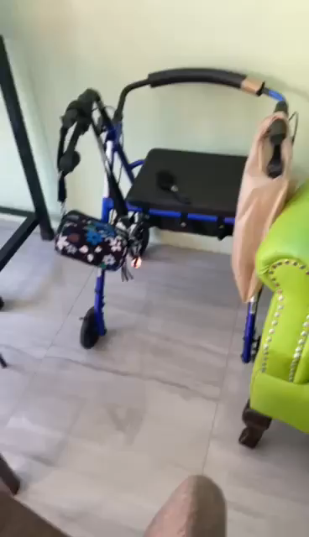
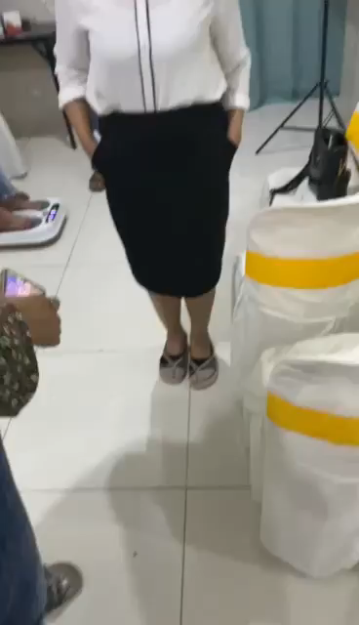
TESTIMONIES

Slide 33
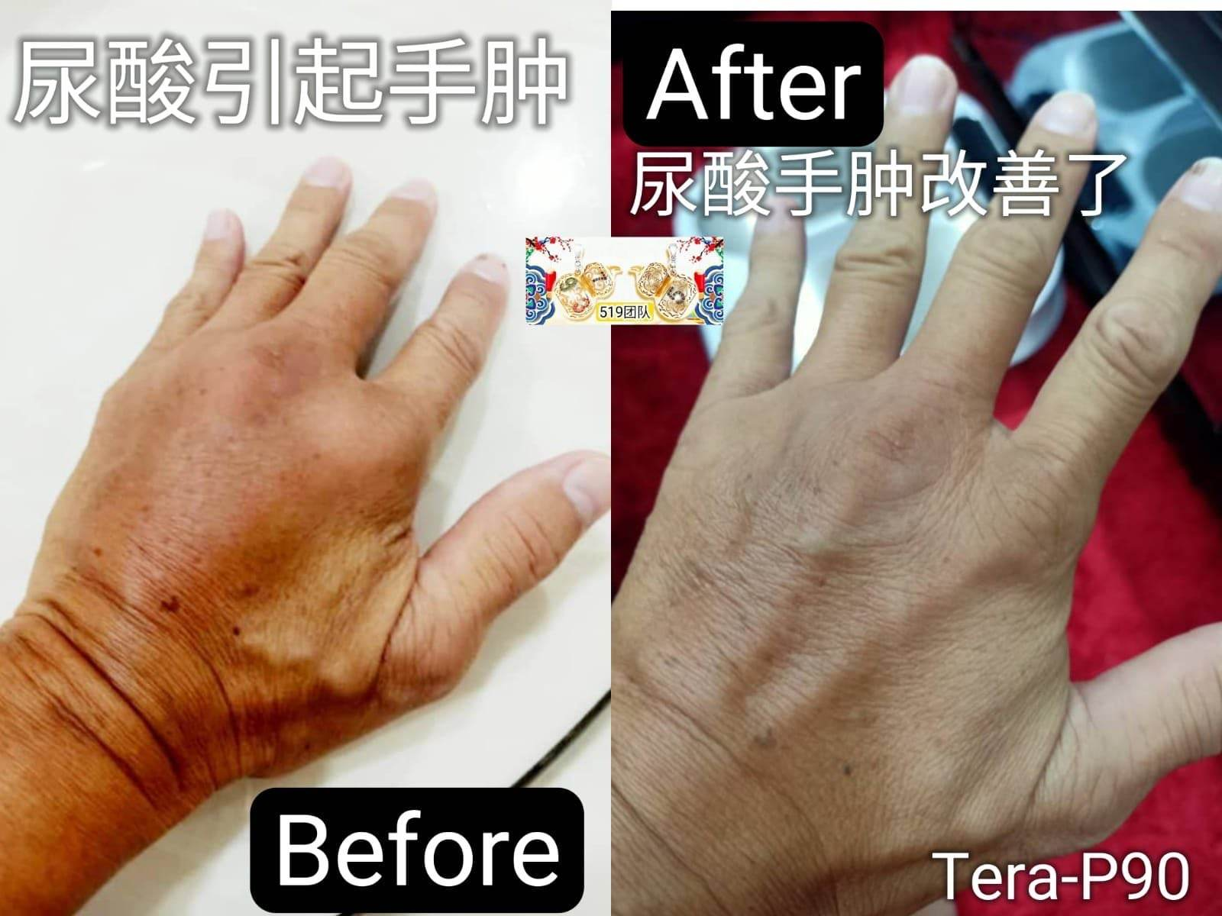
Uric acid causes hand swelling

Slide 34
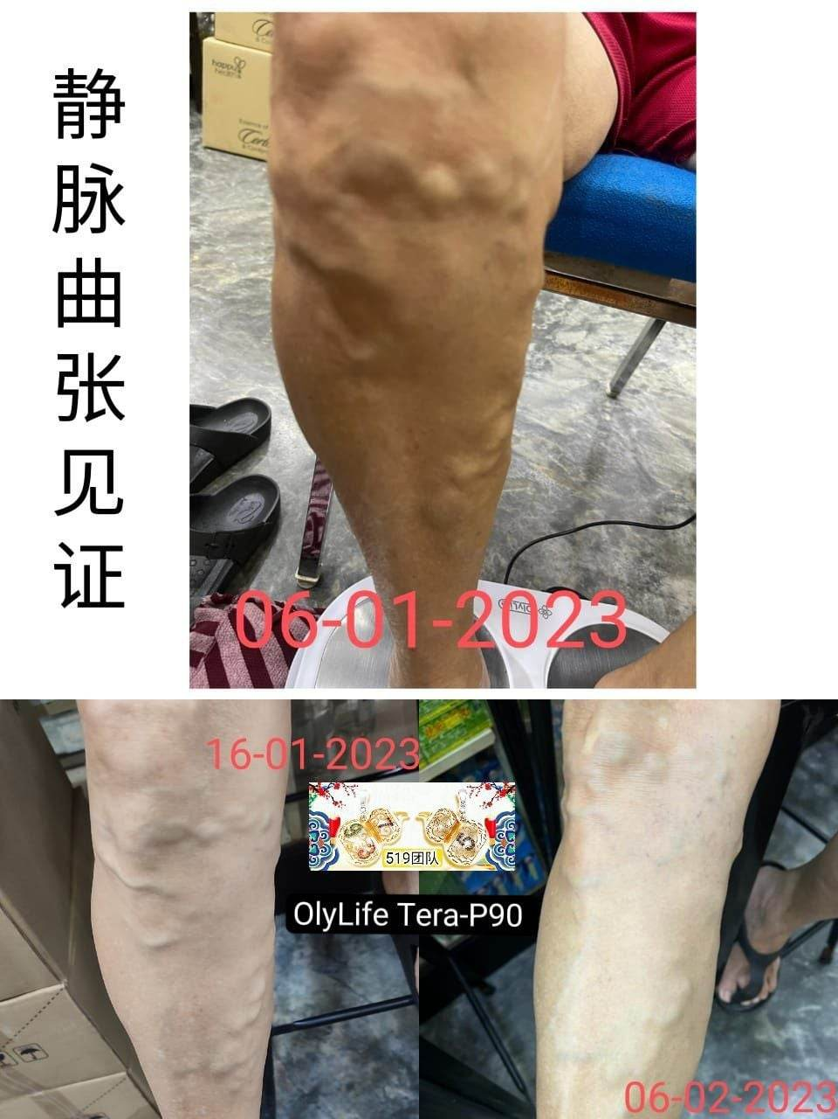
Varicose veins

Slide 35

Empowering health and enriching life
Notes:
Olylaife 透过优质的产品为我们每一个人的健康加冕，成就美好理想人生，我们一起赢！

